Slide 1
International Networks and Supply Chain Flows
Prof. Dr.-Ing. Frank Gillert
University of Applied sciences Wildau

Slide 2
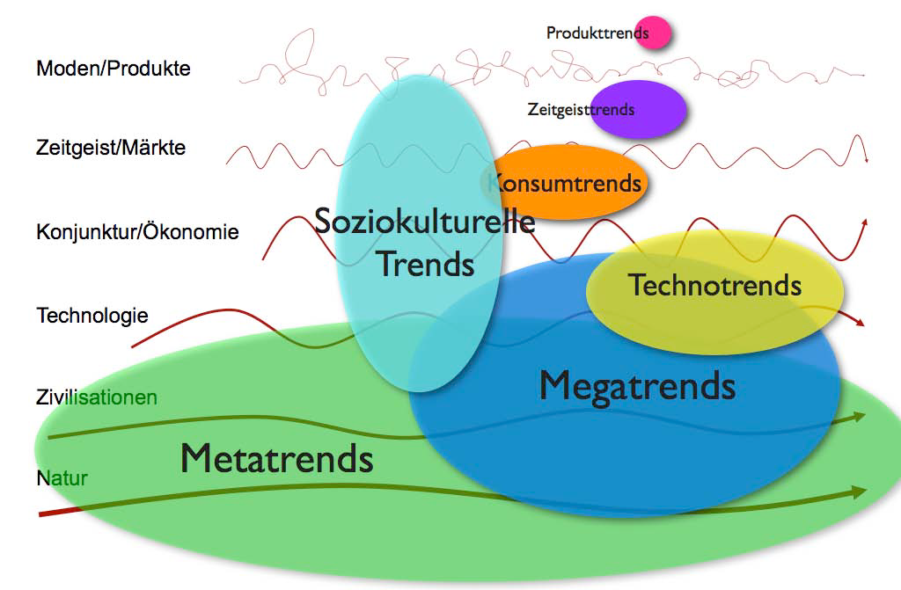
Our business environment – Opportunities and Threats
Fashion/Products
individualization
female shift
silver society
new Learning
new work
health
neo-ecology
connectivity
globalization
urbanization
mobility
Spirit of time/Markets
Boom/Economy
Technology
Civilization
Nature
wwww.zukunftsinstitut.de/Horx
8 Megatrends (Thomsen)
markets of the future
development of world politics
mechanization/technization
acceleration
individualization
globalization
resources
demographic development

Slide 3
Evolution and Paradigm Shifts in and with the ICT
Source:Fleisch (2005)

Slide 4
Megatrends with Relevance to Logistics
Globalization
shortened product and technology life cycles (acceleration)
rising individualization
increasing environmental sensibility (limited resources)
political and economical shifts
crisis-related trends such as climate change and increasing incidents of terrorism

Slide 5
Conclusions for Logistics (1)
Four “mega-trends” that determine logistics demand:
1 | Globalization of production and commercial traffic - Growing transport distances, increasing logistics demand in expansive networks, new needs for communication and integration, heightened intensity of competition
2 | Crossover to post-industrial society - End of growth of industrial production of goods in western European countries; instead growing needs for individualized products and the increasingly frequent adding on of services to physical goods
3 | Tact acceleration of business in the on-demand world - Instead of stockpiling, “just-in-time” reaction to customer orders, shortening of technology and product life-cycles, time-based competition and resulting “atomization” of order and goods structures, increasing flexibility of logistics systems and growing importance of asset management
4 | Growing external threats and environmental consciousness - Growing threats to logistics systems through terrorism and political action, as well as increasing awareness of the threats; awareness of the use of energy and space as well as emissions caused by the logistics. Due to these factors, dramatically climbing security, prevention and sustainability demands, extension of logistics chains, increased complexity of logistics processes
Source: Klaus, Kille (2008 ) in Gleißner (2011 )

Slide 6
Conclusions for Logistics (2)
Four “mega-trends” that are changing logistics supply:
(Re-) discovery of positive effects of the optimized structure and process organization - Advancement of exclusively pull-orineted supply chain management with JIT and CRP, escalating requirements placed on process and IT know-how, success factors “lean process management” and “event management”
New logistics design options through technological progress - Increasing interconnectedness of the world through the Internet, comprehensive tracking, monitoring and automation of object and information streams via RFID and smart objects technologies
Deregulation and privatization of previously public services in communications and traffic, appearance of “hybrid” logistics providers - New carriers, new service packages, new competition from previous postal and rail companies, “hybrid” business from the industry, new investors from the finance branch, growing competitive pressure
Concentration on core competencies, shareholder value oriented thinking, outsourcing - Driven by financial motives, a focus on simplification and management of capital investment, headcount and outsourcing
Source: Klaus, Kille (2008 ) in Gleißner (2011 )

Slide 7
Megatrend Effects as Sphere of Activities
requires
    Miniaturization
    Digital Convergence
    Machine-to-Machine
    Ubiquitous Computing
    Standardization
    Governance
    Legitimation
    Communication
    Global Collaboration
    Real Time Enterprise
    Not where, but who
    Mass customization
enable
maintain
demand
Flexibility and Agility

Slide 8
What is vital for success and sustainability?
Strategic cooperation in the supply chain is not enough by itself to reduce the bullwhip effect. With the currently perceptible nature of the effect, it is necessary for processes to adapt to the agility of the customers, and this adaptation is only possible with near-real-time information. Consequently, the business process optimization models can only be generally effective if they are based on near-real-time information, such as is possible with RFID.
Source: Gillert,Hansen (2007)

Slide 9
Supply Chain Challenges at a Glance
Target cost areas
Capital employed
Transaction cost
Out of Stock cost
But:
Retail
Lieferant
Retail
-
Supplier
Hersteller
Manufacturer
Distributor
Distributor
Kunde
Unternehmen
Customer
Aufträge Hersteller
Orders to Supplier
Orders to Manufacturer
Aufträge Distributor
Orders to Distributor
Aufträge Hersteller
Aufträge Distributor
Aufträge Retailer
Verkauf an Kunden
Aufträge Retailer
Verkauf an Kunden
an Lieferant
Sales to Customers
an Lieferant
an Hersteller
an Hersteller
an Distributor
an Distributor
20
20
20
20
15
15
15
15
10
10
10
10
5
5
5
5
0
0
0
0
Zeit
Zeit
Time
Zeit
Time
Zeit
Zeit
Time
Zeit
Zeit
Time
Zeit

Slide 10




Analogy for SCM Challenges (1)
best practice = 120 km/h cont.
Subsystem 1
Subsystems n
stress
in a rush
headless
Substantive
radio traffic service
Interpretation of
behavior of person in front
pushi
conspicuous manner
Information area
Prognostic area
Subsystem 2

Slide 11
The only inconvenience is the customer (Geffroy)
Hybrid or multi-optional behaviour
Variety seeking
Smart shopping
“Hybrid or multi-optional behaviour refers to individual variance in purchasing behaviour. For instance, a consumer may purchase her daily necessities at a discounter but treat herself to luxury car with expensive extras. By contrast, variety seeking behaviour results exclusively from a need for change. Smart shoppers act quasi-professionally by concentrating on the entire economic context of pricing in the same way as a supply chain manager. Quality and market awareness are certainly predominant factors with smart shoppers, which distinguishes them from bargain hunters who focus on low cost. Smart shoppers utilize all available resources such as the Internet, bypass traditional links in the value chain such as specialist retailers, and buy directly from producers. The first two strategies listed above are demand-driven behaviour patterns. By contrast, smart shoppers are trained as well as served by the supply side. This quasi-professional form of customer behaviour is roughly comparable to the methods of B2B processes [Werle2005].”
Source: Gillert,Hansen (2007)

Slide 12
Causes for the Bullwhip Effect in the Supply Chain (1)
Demand forecasts
The supply chain participants forecast their future sales from previous key figures and add a safety margin to compensate for lead time. The retailer can keep this margin relatively small due to its proximity to the consumer, but this behaviour generates a cumulative effect in upstream feedback stages that produces large variations.
Price fluctuation
If a product is subject to wide price fluctuations, customers are tempted to build up reserves when prices are low.
Quelle: Gillert/Hansen (2007)

Slide 13
Causes for the Bullwhip Effect in the Supply Chain (2)
Shortage gaming
If a shortage situation arises due to high market demand, the upstream stages will ration their products such that their customers, such as the retailer, receive products in proportion to their previous order quantities. The retailer will thus attempt to compensate for the feared reduction by increasing its current order quantity. This can cause the supplier at the head of the chain to drastically misjudge the market situation due to lack of information.
Order batching
Discount incentives and reduced processing costs encourage customers to batch their orders. This batching amplifies the bullwhip effect.
Quelle: Gillert/Hansen (2007)

Slide 14
Transaction Cost Ex ante
Information gathering costs
e.g. search for information about potential transaction partners
Initiation costs
e.g. contact
Agreement costs
e.g. negotiations, contract formulation, agreement

Slide 15
Transaction Cost Ex post
Settlement costs
e.g. brokerage fees, transportation costs
Control costs
e.g. compliance deadline, quality, quantity, price and non-disclosure agreements, acceptance of delivery
Modification costs / adjustment costs
e.g. deadline, quality, quantity and price changes

Slide 16
Conclusion: Transaction COSTs
More specifically, is meant by transaction cost search, when initiating, information, attribution negotiation, decision, agreement, settlement, hedging, enforcement, inspection, adjustment and termination costs.
Transaction costs arise, when communication needs occur between the people involved in a transaction, which result in communication problems, misunderstandings or conflicts.

Slide 17
The Media Break
Source: Gillert,Hansen 2007

Slide 18
Analogy for SCM Challenges (2)
best practice = 120 km/h cont.
Subsystem 1
Subsystems n
The view through the windshield
of the person in front
stress
in an rush
headless
Computes
information
Reduction of asymmetric
Increasing trust
Information area
Subsystem 2

Slide 19
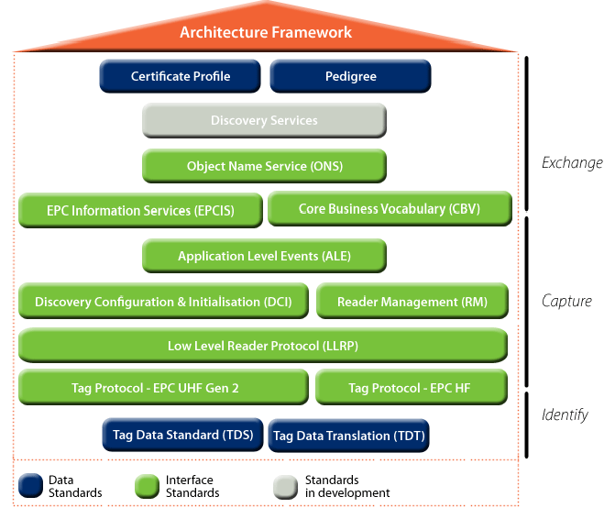
Epc Global Framework

Slide 20
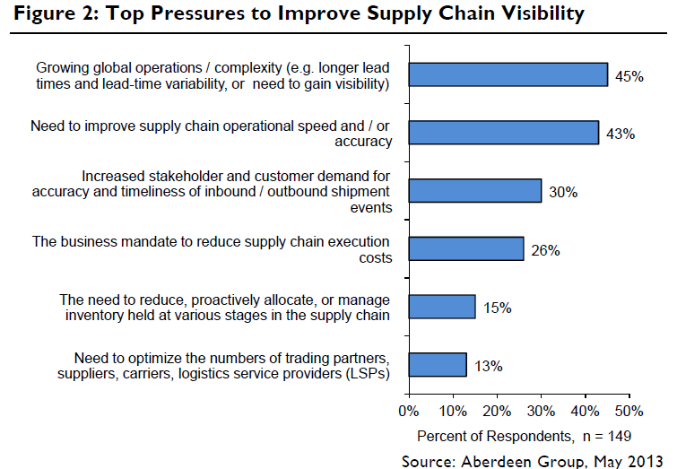

Slide 21
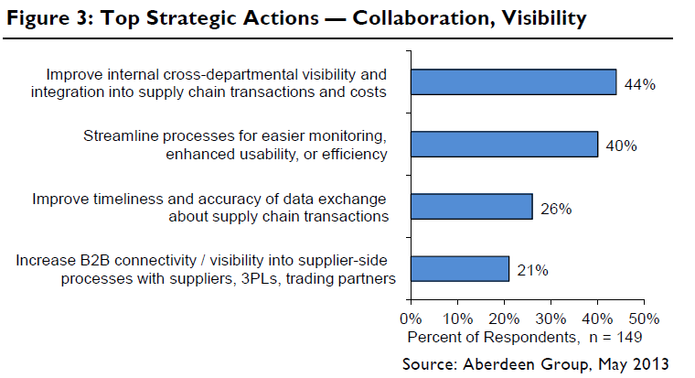

Slide 22
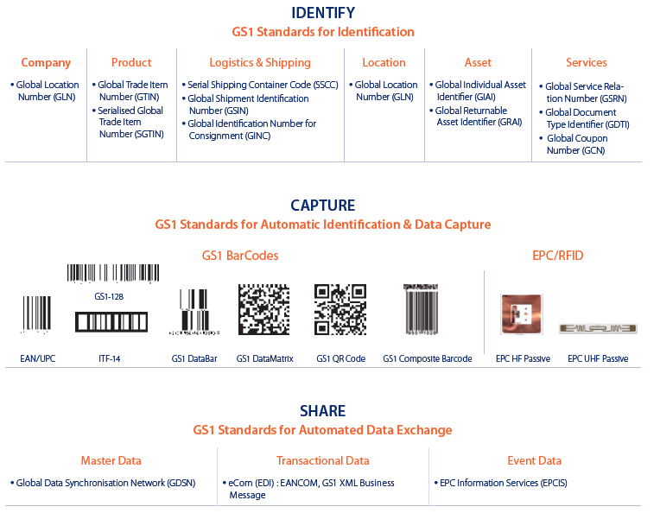
GS1 Standards Framework - just one example for a specific Industry
Source: GS1 Supply Chain Visibility Framework

Slide 23
Why is it so hard to solve the issues in collaboration?
“This analysis of the bullwhip effect leads to a clear realization that the enterprises in the supply chain can only reduce the effect by collaboration, or in other words by working together. ‘Efficient Consumer Response’ (ECR) is a method for dealing with this situation. Progressive enterprises have been devoting attention to this subject for more than a decade already. One of the main pillars of ECR is using a standardized method (EDI) to provide and exchange data, especially specific point-of-sale (POS) data, and conveying this data to the upstream links of the supply chain in near real time. RFID can support this process, and with its higher degree of automation and ability to identify individual items it can surpass existing barcode systems.
Providing POS data on the basis of item barcodes would unquestionably be possible even now. However, exchanging this sort of data is still hampered by resistance arising from business policies.”
It is all about trust!

Slide 24
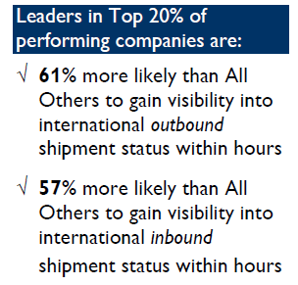

Slide 25
Supply Chain Operation reference Model (SCOr)

Slide 26
On the Supply Chain Council
The Supply Chain Council (SCC) was founded in 1996
  Independent, non-profit association
  1,000 companies
  For a variety of industries
  Goal was to develop an industry-independent standard process reference model for Information exchange between:
      Companies & Supply Chain

Slide 27
SCOR Essentials
SCOR model is a tool to
Improve SC processes
Higher transparency and comparability of SC performance
Understand the supply chain
Review the processes
Benchmark
    Standardization is key!
„Standards is the
glue that holds
the supply chain
together“
Alexander Zeier

Slide 28
What is a Process Reference Model?
    Process reference models integrate the well-known concepts of business process reengineering, benchmarking, and process measurement into a cross-functional framework
Business Process
Reengineering
Benchmarking
Best Practices
Analysis
Process Reference
Model
Capture the „as-is“ state of a process and derive the desired „to-be“ future status
Quantify the operational performance of similar companies and establish internal targets based on „best-in class“ results
Characterize the management practices and software solutions that result in „best-in-class“ performance
Capture the „as-is“ state of a process and derive the desired „to-be“ future state
Quantify the operational performance of similar
companies and establish internal targets based on „best-in-class“ results
Characterize the management practices and software solutions that result in „best-in-class“ performance
Source: SCC

Slide 29
Contain of a Process Reference Model
Standard descriptions of management processes
A framework of relationships among the standard processes
Standard metrics to measure process performance
Management practices that produce best-in-class performance
Standard alignment to features and functionality
Once a Complex Management Process is Captured in Standard Process Reference Model Form, It can Be:
  Implemented purposefully to achieve competitive advantage
  Described unambiguously and communicated
  Measured, managed, and controlled
  Tuned and re-tuned to specific purpose

Slide 30
What is SCOR?
SCOR is a supply chain process reference model containing over 200 process elements, 550 metrics, and 500 best practices including risk and environmental management
Organized around the five primary management processes of Plan, Source, Make, Deliver and Return
Developed by the industry for use as an industry open standard – any interested organization can participate in its continual development
Source: SCC

Slide 31
One Method Internationally Accepted
Plan
Plan
Plan
Plan
Plan
Deliver
Source
Make
Deliver
Source
Make
Deliver
Source
Make
Deliver
Source
Suppliers’
Supplier
Supplier
Your Company
Customer
Customer’s
Customer
Internal or External
Internal or External
Return
upstream
downstream
www.supply-chain.org

Slide 32
Scope of SCOR Processes
SCOR Process | Definitions
Plan | Processes that balance aggregate demand and supply to develop a course of action which best meets sourcing, production and delivery requirements
Source | Processes that procure goods and services to meet planned or actual demand
Make | Processes that transform product to a finished state to meet planned or actual demand
Deliver | Processes that provide finished goods and services to meet planned or actual demand, typically including order management, transportation management, and distribution management
Return | Process associated with returning or receiving returned products for any reason. These processes extend into post-delivery customer support

Slide 33
Structure of SCOR Model
SCOR spans:
All Customer interactions, from order entry trough paid invoice
All Product (physical material and service) transactions, from your supplier´s supplier to your customer´s customer, including equipment, supplies, spare parts, bulk product, software, etc.
All market interactions, from understanding of aggregate demand to the fulfillment of each order
Supplier
processes
Supply Chain
Customer
processes
Plan
Source
Make
Deliver
Return
Return
Process, arrow indicates material flow direction
Process, no material flow Information flow
Source: SCC

Slide 34
End-to-End Supply Chain
The five integrated processes provide a boundary-free view of the true end-to-end Extended Supply Chain
Supports intra- and cross-enterprise optimization of arbitrary scale
Components
Sub assemblies
Manufacturer
Retailer
Consumer
Plan
Source
Make
Plan
Return
Deliver
Source
Make
Plan
Source
Plan
Return
Deliver
Make
Source
Plan
Return
Deliver
Make
Source
Return
Deliver
Make
Return
Deliver
Supplier´s Supplier
Supplier
Company
Customer
Customer´s Custom.
Source: SCC

Slide 35
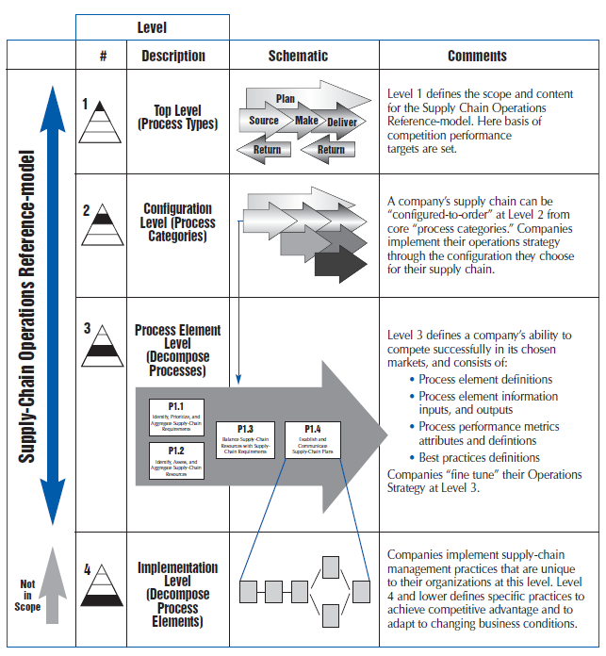
SCOR Contains three levels of Process details

Slide 36
SCOR Hierarchy
Top Level
Configuration Level
Process Element Level
Implementation Level
Supply-Chain
Source
S1 Source
Stocked Product
S1.2
Receive Product
Differentiates Business
Delfines Scope
Sets Strategy
Differentiates
Complexity
Differentiates
Capabilities
First Tier Diagnostics
Names Task
Links, Metrics, Task or Practices
Second Tier
Diagnostic
Sequences Steps
Job Details
Industry or company specific
Standard SCOR definitions
Company/Industry
definitions
Source: SCC

Slide 37
Main KPI in SCOR
Perfect Order Fulfillment
Order Fulfillment Cycle Time
Upside Supply Chain Flexibility
Upside Supply Chain Adaptability
Downside Supply Chain Adaptability
Overall Value at Risk (VAR)
Total Cost to Serve
Cash to Cash
Return on Fixed Assets
Return on Working Capital

Slide 38
SCOR Process Codification
SCOR processes have unique identifiers:
One capital only are level 1 processes: P, S, M, D and R (5 in total)
A capital plus a number are level 2: P1, S2, M3, D2, D4 (15 total)
Two groups of exceptions for level 2:
  Enable: EP, ES, EM, ED and ER (5 in total) and
  Return: SR1, DR1, SR2, DR2, SR3, DR3 (6 in total)
A capital plus number, a period and a number are level 3 processes:
  P1.1, P1.2, S2.1, M1.5, D3.12 (111 processes in total)
  Two groups of exceptions for level:
    Enable: EP.1, ES.3, EM.4, ED.8, ER.1 (47 in total)
    Return: SR1.1, DR1.3, SR2.2, DR2.4, SR3.5, DR3.1 (27 in total)
X = level 1, Xn = level 2, Xn.m = level 3

Slide 39
Internationalization

Slide 40
Export from germany to China (Mrd. €)
Quelle: Statistisches Bundesamt, genesis.destatis.de

Slide 41
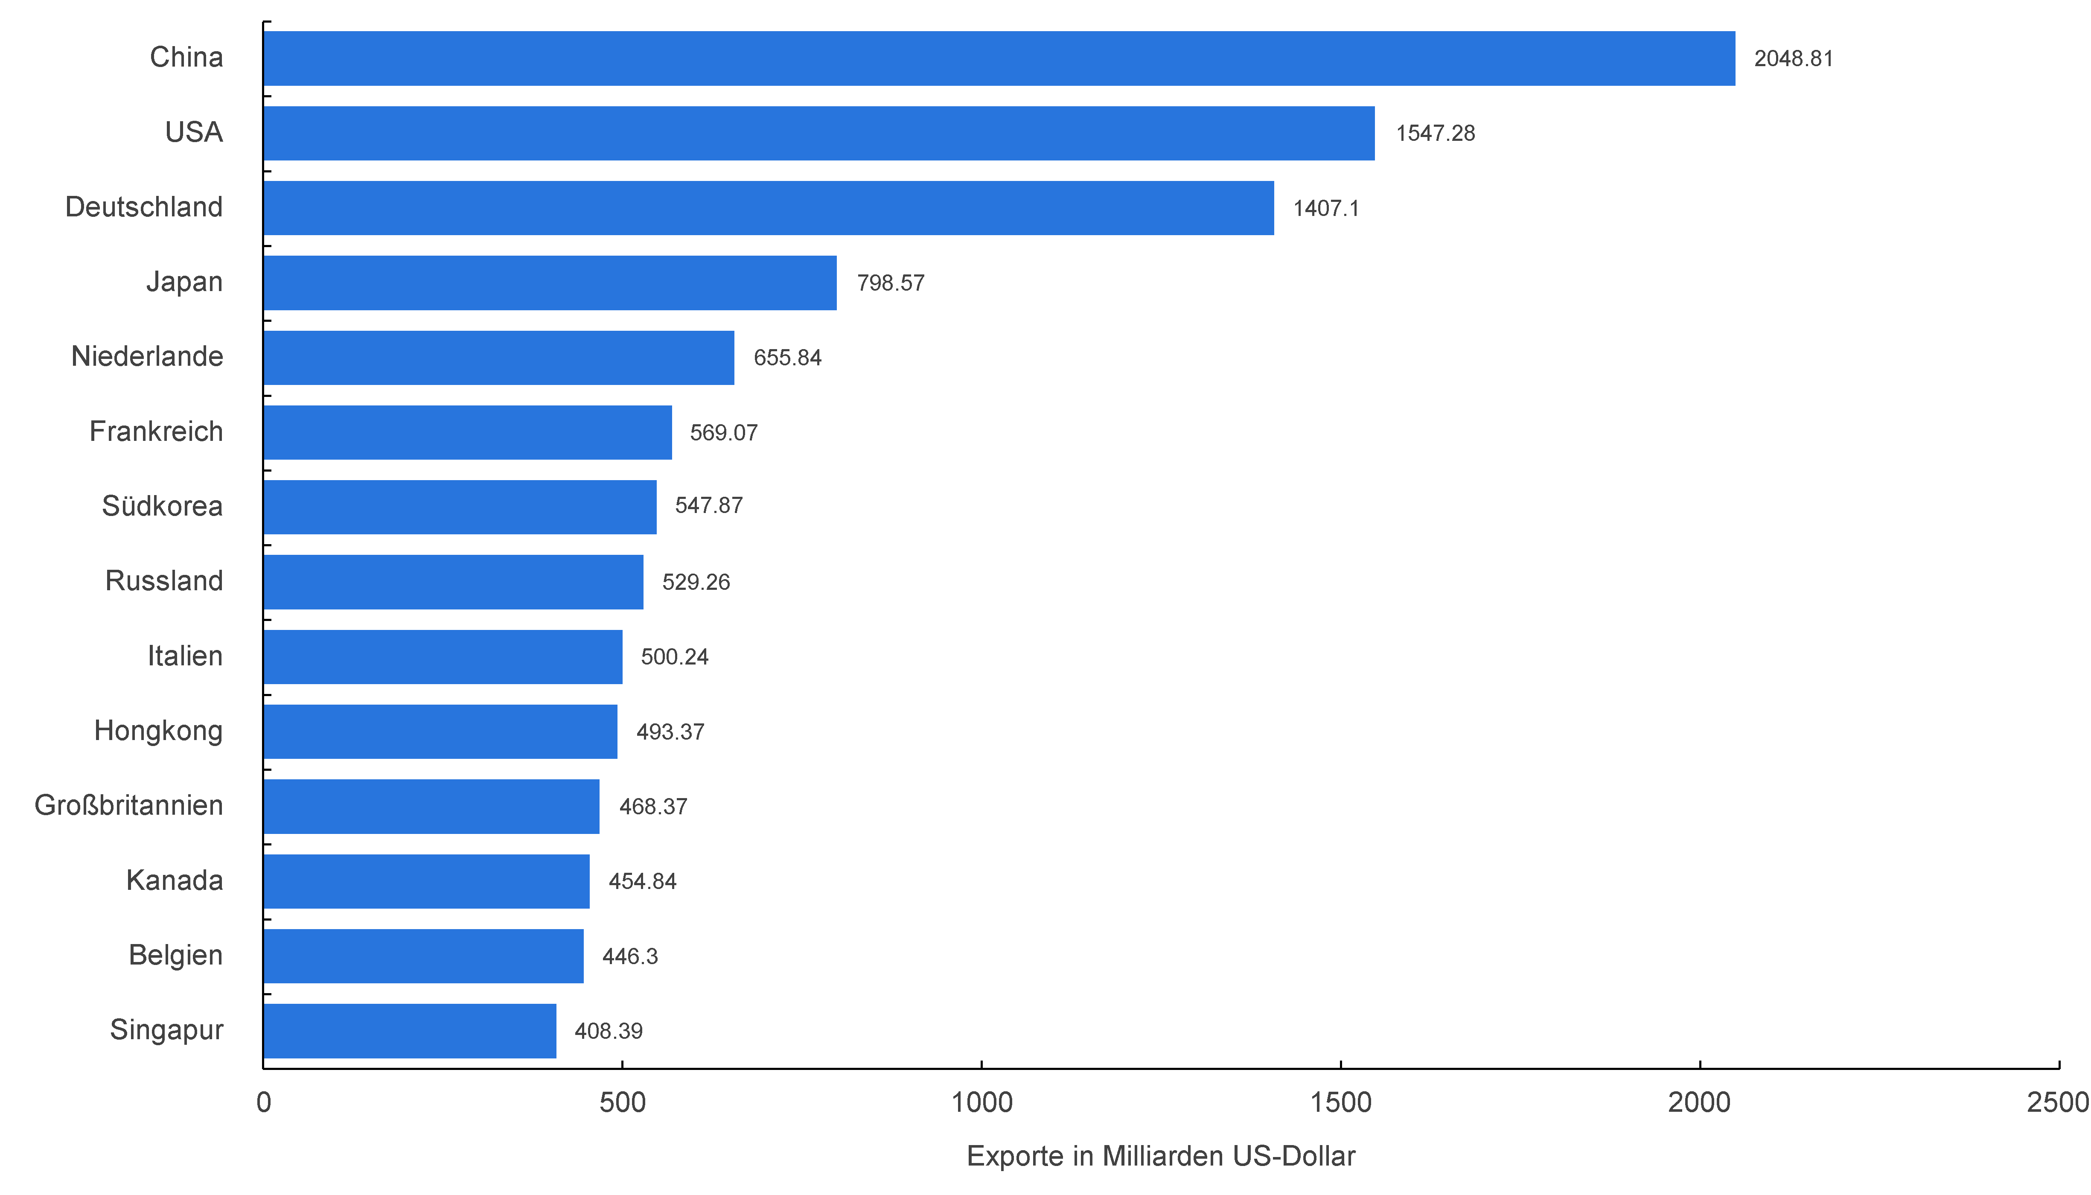
20 largest export nations 2012 (mrd. $)
Quelle: WTO, wto.org

Slide 42
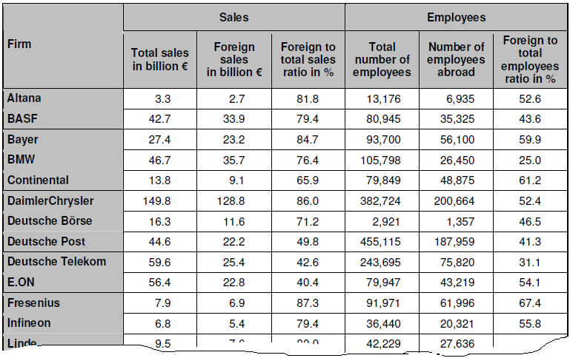
Foreign ratios of selected DAX firms (data as of 2005)
Source: Schmidt (2009)

Slide 43
Classic supply chain - Model of a three-stage linear supply chain
Information flow
Source: Gillert,Hansen 2007

Slide 44
Consumer Goods supply chain
Source: Gillert,Hansen 2007

Slide 45
Global Supply Net complexity
Source: Gillert,Hansen 2007

Slide 46
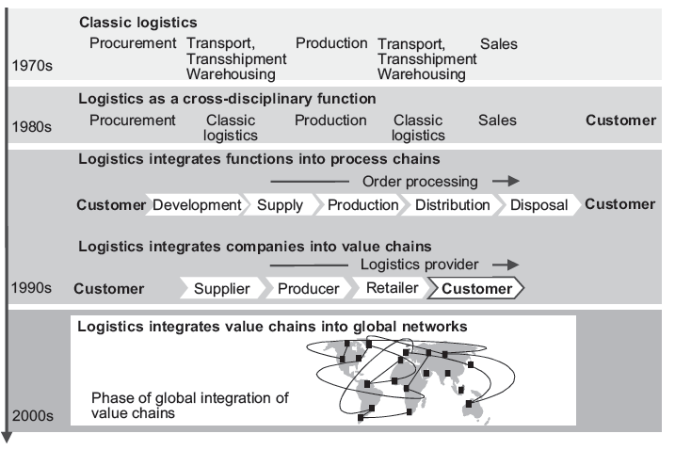
The evolution of Logistics Strategies

Slide 47
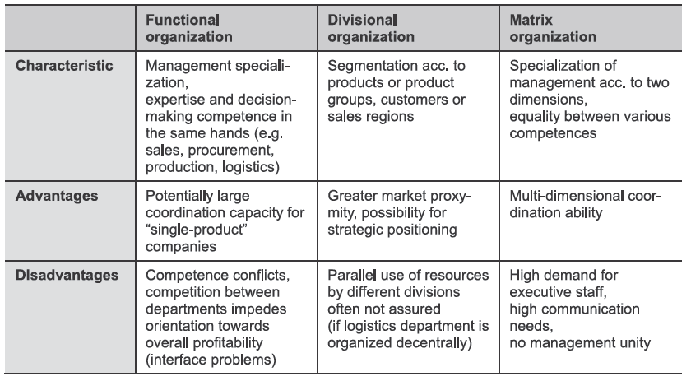
Supply chain Units - Where am I?
Source: Froschmayer 2011

Slide 48
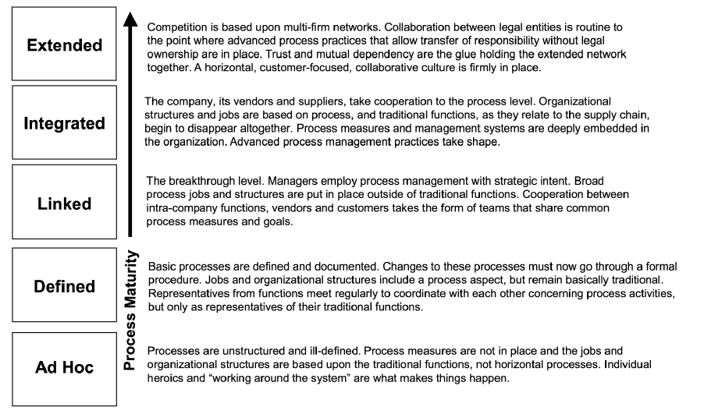
Process Maturity Model
Lockamy,McCormack, Bingley (2004)

Slide 49
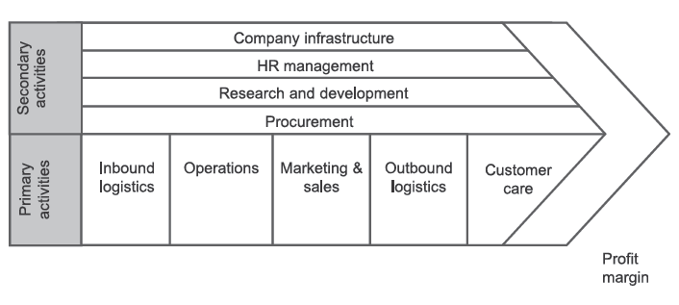
What are the competencies and value
Is it worth doing it?
Source: Porter

Slide 50
Business Opportunities regarding Logistics
Attractiveness of differentiation in logistics
Attractiveness of logistics cost
high
Ease to
influence
differentiation criteria
high
Ease to
influence
logistics
cost
mid
mid
low
low
low
mid
high
low
mid
high
Attractiveness of logistics
high
logistics
Attractiveness of logistics cost
high
mid
logistics
attractiv-ness
mid
mid logisticsattractiv.
attractiv-ness
low
low
mid
high
Attractiveness of differentiation
Source: Pfohl 2004

Slide 51
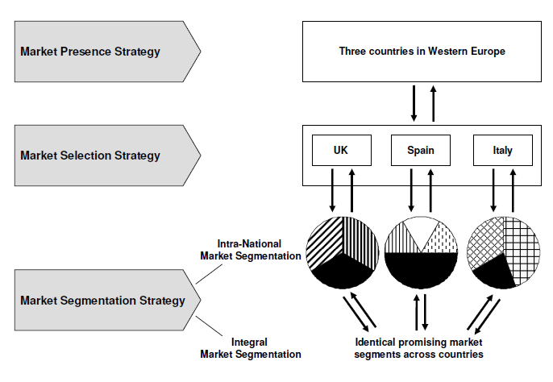
Go-To-Market Strategies
Source: Schmidt (2009)

Slide 52
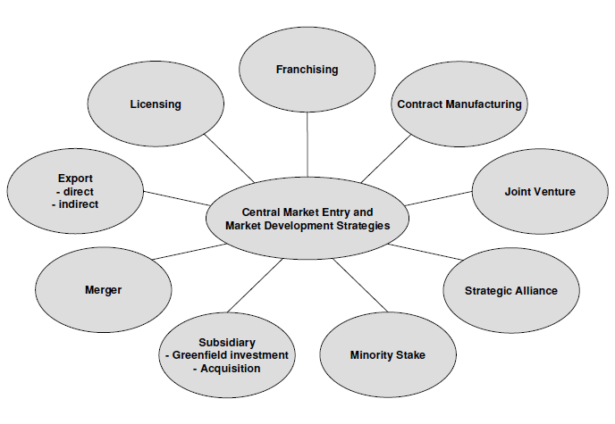
Business Set up for Internationalization
Source: Schmidt (2009)

Slide 53
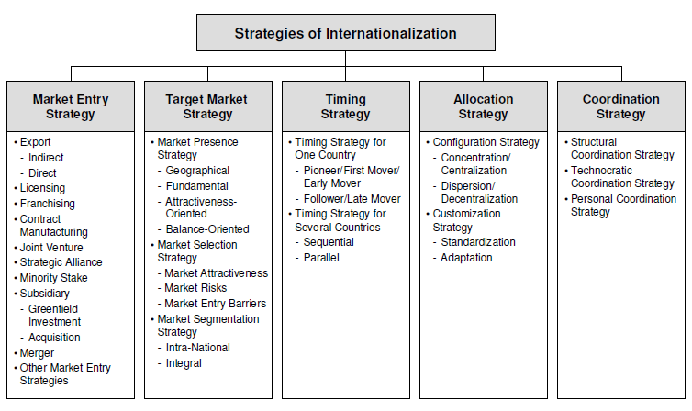
Types of Strategies to internationalize
Source: Schmidt (2009)

Slide 54
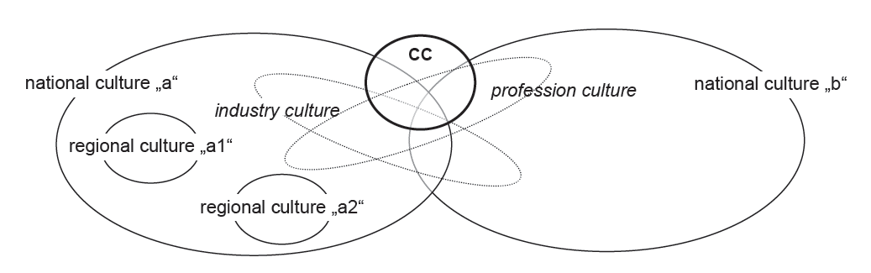
Manifold aspects regarding culture
Source: Schneider/Barsoux (1997)

Slide 55
Risk Assessment for Different Structural Approaches (1)
SCRM
Robustness
Agility
supply
demand
Inter-organizational trust
Environmental uncertainty
Partner perfomance
Partner asymmetry
Lack of experience in cooperation
Source: Wieland&Wallenburg (2012)

Slide 56
Risk Assessment for Different Structural Approaches (2)
Relational Risks
Market
low
high
Hierarchy
Performance Risks
Hierarchy
low
high
Market
Quelle: Billitteri et.al. (2013)

